Slide 1

HOUSING: PRICE PREDICTION
By – Shweta Mishra
Fliprobo – Internship 30

Slide 2
Problem Statement
A US-based housing company named Surprise Housing has decided to enter the Australian market. The company uses data analytics to purchase houses at a price below their actual values and flip them at a higher price. For the same purpose, the company has collected a data set from the sale of houses in Australia.
It is required to build a model using Machine Learning in order to predict the actual value of the prospective properties and decide whether to invest in them or not.
For this company wants to know:
1- Which variables are important to predict the price of variable?
2- How do these variables describe the price of the house?
How to construct a realistic model to precisely predict the price of real estate has been a challenging topic with great potential for further research.
Our main objective of doing this project is to build a model to predict the house prices with the help of other supporting features.

Slide 3
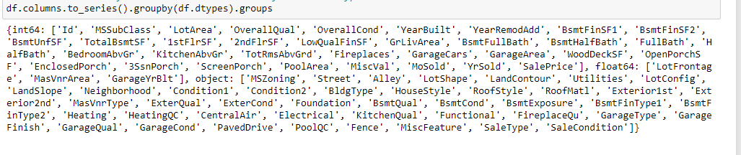
Data Sources and their formats
Data contains 1460 entries each having 81 variables
Two datasets are being provided to you (test.csv, train.csv).
1. Train file will be used for training the model, i.e., the model will learn from this file. The dimension of data is 1168 rows and 81 columns.
2.Test file contains all the independent variables, but not the target variable. The dimension of data is 292 rows and 80 columns.

Slide 4
Project Flow Tasks Perform
Data Integrity Check For presence of duplicate or any data error.
Missing values present in data set. Features containing more than 40% missing value are drop from investigation.
Imputation of missing value with mean, median or mode is performed.
Feature Engineering for extraction of few new features out of existing features.
Feature selection
Label Encoding of Categorical features
Splitting of dataset into input & target feature
Standard Scaling of data

Slide 5
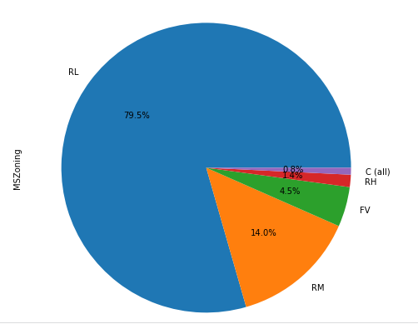
Data Analysis
In this section we go through some key insight from dataset –
As we have lot of features We see here only key visualization
79.5% of House properties belongs to Low Density Residential Area followed by 14 % of properties belong to Medium Density Residential Area.

Slide 6
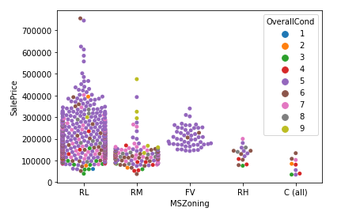
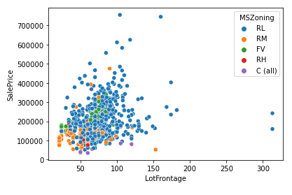
Most of property for sale have overall condition rating of either 5 or 6.
Sale Price inside RL Zone is much higher than other remaining zone.
Cheapest properties are available in Commercial zone.
Some house properties having Overall condition Rating of 8 & 9 have low price compare to others.
Lot Frontage area increase (which indicate Size of street connected to property) the Sale Price increases.

Slide 7
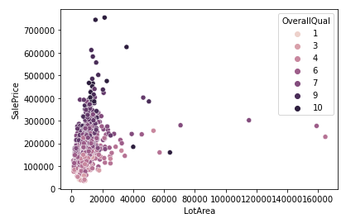
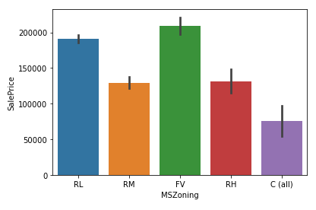
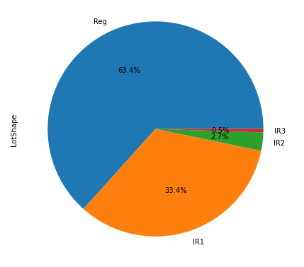
Average Sale price house properties belonging to Floating Village Residential Zone are costlier than Others
63.4% house properties are regular in shape.

Slide 8
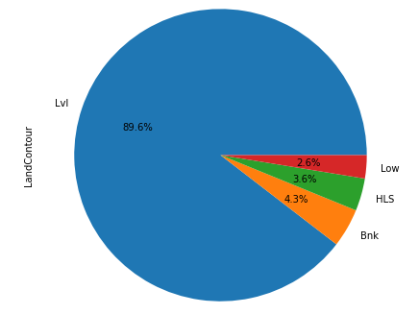
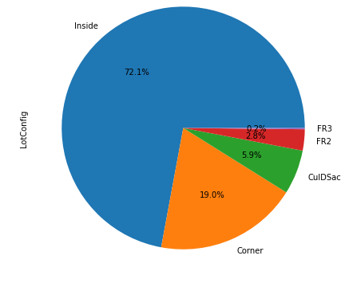
89.6% of House properties are near flat level surface
Around 72 % of house comes with inside Lot configuration.

Slide 9
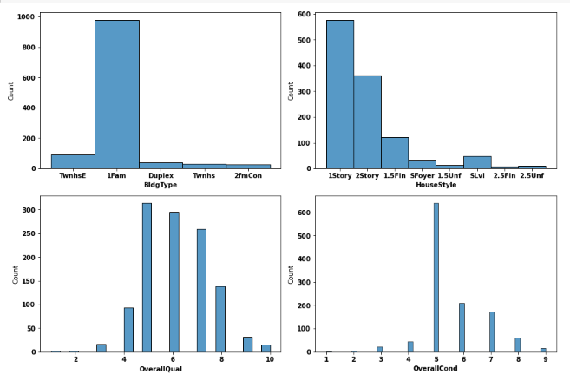
More than 950 house properties are with building type Single-family Detached.
More than 50% of house properties comes with Overall Condition Rating of 5.
More than 75% of house properties come with overall Quality Rating varies between 5 to 6.
More than 500 House Properties comes with one story dwelling.

Slide 10
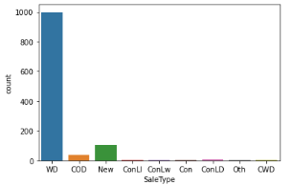
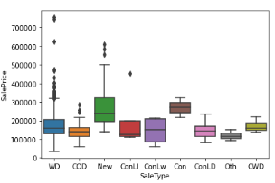
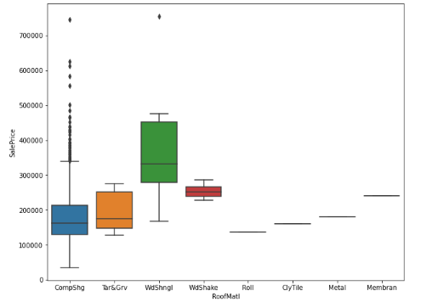
Around 1000 sales happen by Conventional Warranty Deed.
Home just constructed and sold category are exceptionally much costlier than anyone else.
All loan-based sale is below 300000.
90% Properties in Data set made with roof material of Standard (Composite) Shingle.
Wood Shingles is Costlier Material compare to rest.

Slide 11
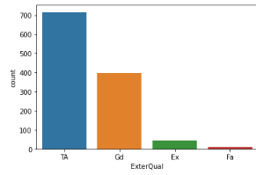
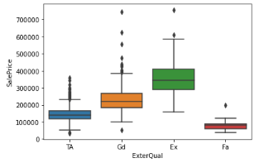
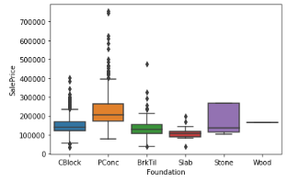
approx. 60% of house properties come with Average Exterior quality and all of them below 400000.
Very few House Properties comes with Excellent Exterior Quality.
Costlier house properties come with Good & Excellent exterior quality
Pconc Foundation are mostly use in costly housing properties.

Slide 12
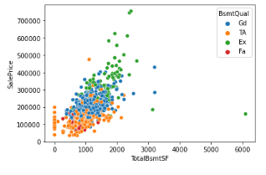
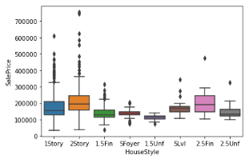
Basement Quality increase in relatio to it sale Price increases.
2 Story Building are costlier than other.

Slide 13
Machine Learning Model Building
Machine Learning Algorithm Used
The different regression algorithm used in this project to build ML model are as below:
Linear Regression
Random Forest Regressor
Decision Tree Regressor
Ridge Regression

Slide 14
ML Model Building Flow
Standard Scaling of Data
Splitting Training Data Using test_train_split
Finding Best Random state
Training ML Model on Different Algorithms
5 Fold Cross Validation of Different Model
Selection of Best Model Based on Evaluation Criteria
Hyper Parameter Tuning of Best Model
Saving final Model Using Joblib

Slide 15
Key Findings and Conclusions of the Study
Algorithm | R2 Score | CV Score
Random Forest Regressor | 89.37 | 82.78
Linear Regression | 87.55 | 76.89
Decision Tree Regressor | 59.84 | 68.31
Ridge Regression | 87.55 | 76.93
Random Forest Regressor Hyper Parameter Tuned Final Model | 88.99 | 82.78

